Slide 1
Emergency Management Program
Jim Montgomery,
Program Manager

Slide 2
Thank-you for the invitation.
On 22nd January 2009,
Pavle Kalinic,Head of Zagreb Emergency Management Office and
John Ash, Head of the City of Ottawa Office of Emergency Management, signed a Declaration and protocol on cooperation and friendship.

Slide 3
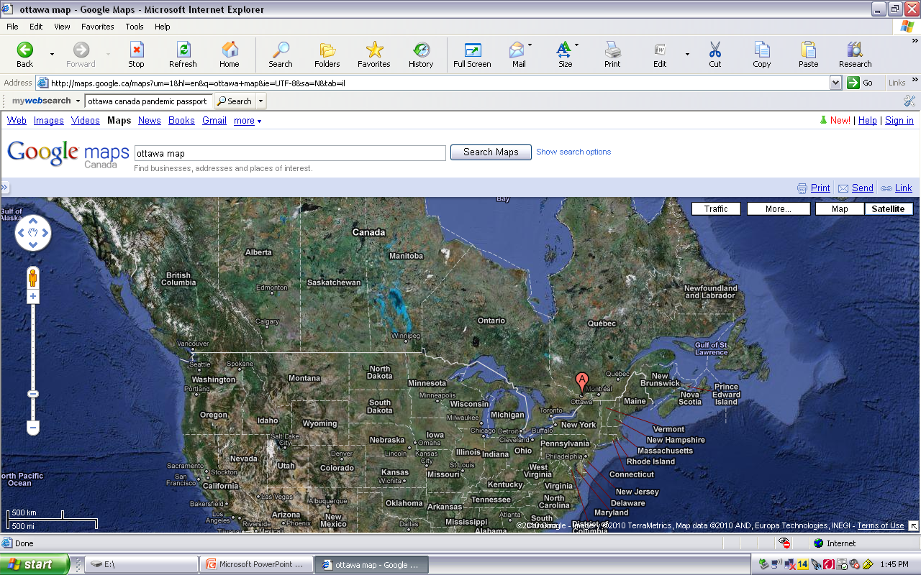
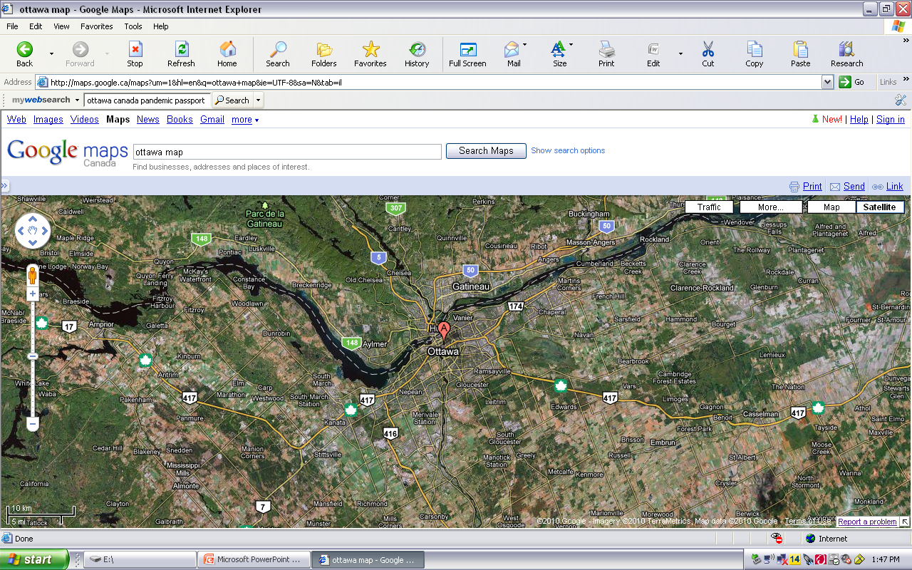

Slide 4
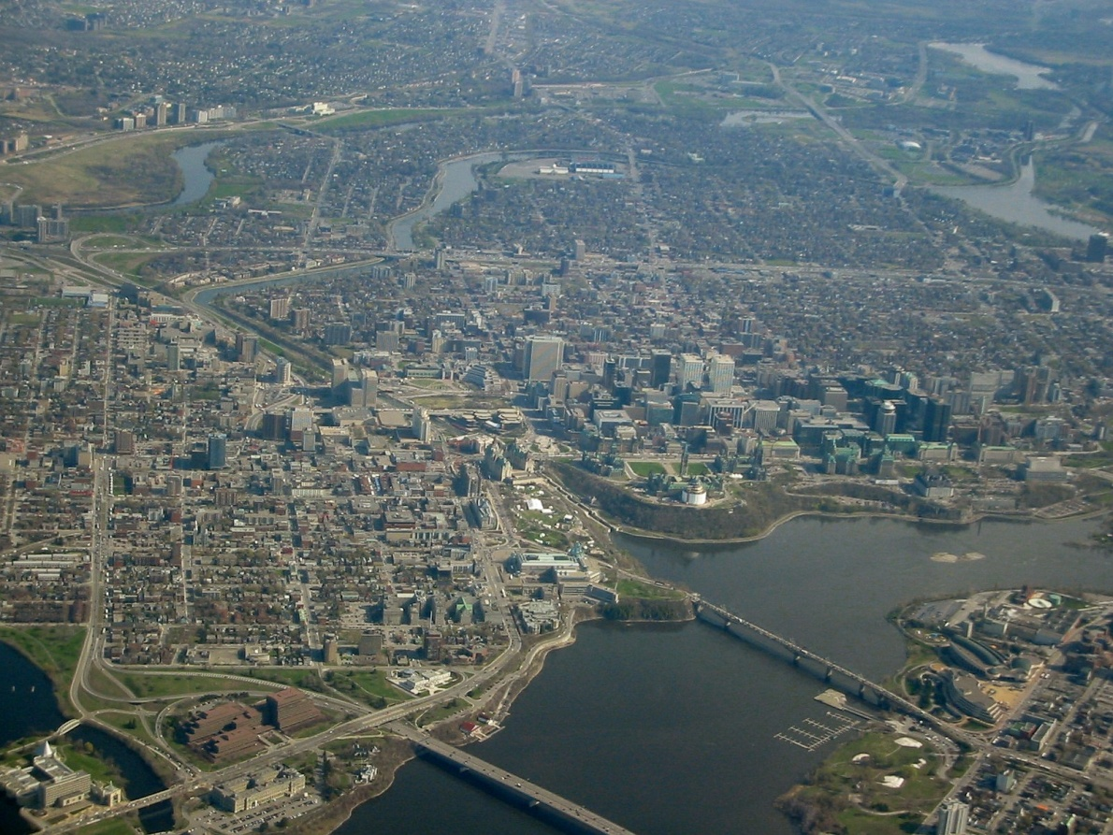
Ottawa is…….
Ottawa, is the capital city of Canada;
a municipality with a population of 992,129 citizens,
an area of 2,778.64 km²,
surrounding areas are designated as the National Capital Region.
Ottawa is the;
2nd highest quality of living of any city in the Americas and the14th highest in the world, and
3rd cleanest city in the world.

Slide 5
Ottawa’s Organizational Structure

Slide 7
Office of Emergency Management

Slide 8
Mandated by the province under the Emergency Management and Civil Protection Act, R.S.O. 1990, the Office of Emergency Management is responsible for managing the:
Emergency Management Program (EMP)
Addresses legislative requirements,
With the goal of enhancing collaboration between all emergency partners,
Prior to, during and after an emergency.

Slide 9
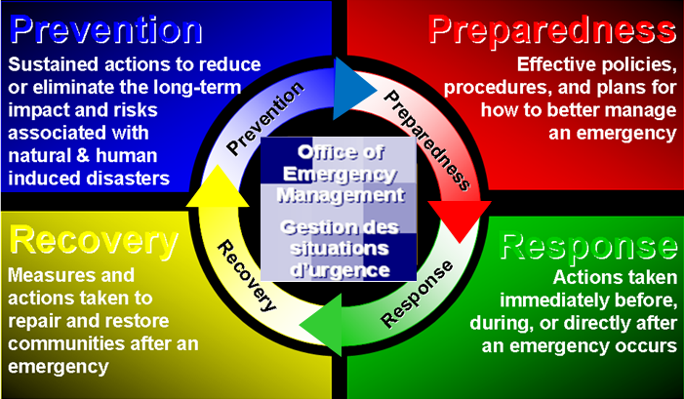

Slide 10
Mandated by the province under the Emergency Management and Civil Protection Act, R.S.O. 1990, the Office of Emergency Management is responsible for managing the:
City of Ottawa Emergency Plan
Reviewed on an annual basis,
Governs the provision of essential services, and
Defines the processes and procedures.

Slide 11
I. Natural Emergencies
II. Human Induced Emergencies
Biological
Human
Animal
Plant
Meteorological/ Elemental
Drought
Flood/Storm Surge/Tsunami
Ice/Snow
Fire
Wind - Tornado/Hurricane
Geological
Earthquake
Landslide
Avalanche
Resulting from:
Acts of God
Non-intentional
Energy
Finance
Information/ Communication
Agriculture
Health
Environment
Transport
Public safety/ security
Government operations
Resulting from:
Human Error
System Failure
Intentional
Energy
Finance
Information/ Communication
Agriculture
Health
Environment
Transport
Public safety/ security
Government operations
Resulting from:
Civil unrest
Terrorism
International Tension
Criminal Acts
War

Slide 12
Top Ten Vulnerabilities
Influenza Pandemic
An earthquake
A radiation-related emergency
Water contamination
A lifeline failure
A weather event
An act of terrorism
An explosion
A demonstration or riot
A hazardous material spill

Slide 13
Mandated by the province under the Emergency Management and Civil Protection Act, R.S.O. 1990, the Office of Emergency Management is responsible for managing the:
Are You Ready Program: Emergency Preparedness Public Education and Awareness Program
Aims to educate employees, community and businesses on the importance of emergency planning.
The better-prepared people are for an emergency, the better the City is able to respond to the emergency.

Slide 14
The Office of Emergency Management (OEM) ensures the safety of all residents and visitors:

Slide 15
Mandated by the province under the Emergency Management and Civil Protection Act, R.S.O. 1990, the Office of Emergency Management is responsible for managing the:
Emergency Management Training and Exercise Program
Multi-agency training and exercise program
For staff and partners that manage, support, command and respond to events,
Test the effectiveness at the multi-departmental level,
Allows for continuous improvement of the City’s emergency response capacity.

Slide 16
Training & Exercise Program
Principles;
Multi-agency
Inter-agency
Inclusive
City
Partners
Public
Private
Progressive
Courses
Emergency Management
Introduction
Basic
Advanced
Incident Command
Awareness
Basic
Intermediate
Advanced

Slide 17
Thank-you
?Questions?

